Slide 1
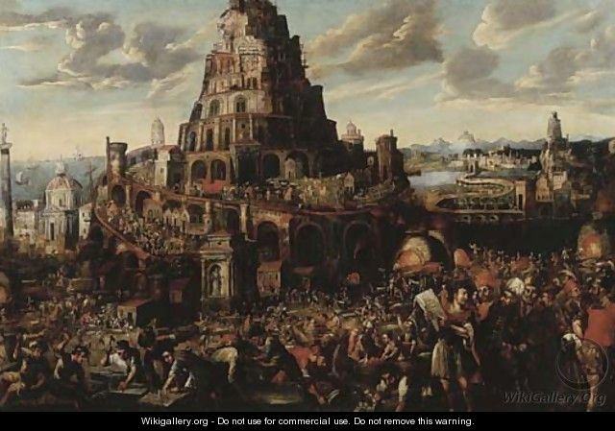
Genesis 10.1-11.9
painting by Gillis Van Valckenborch; wikigallery.org

Slide 2
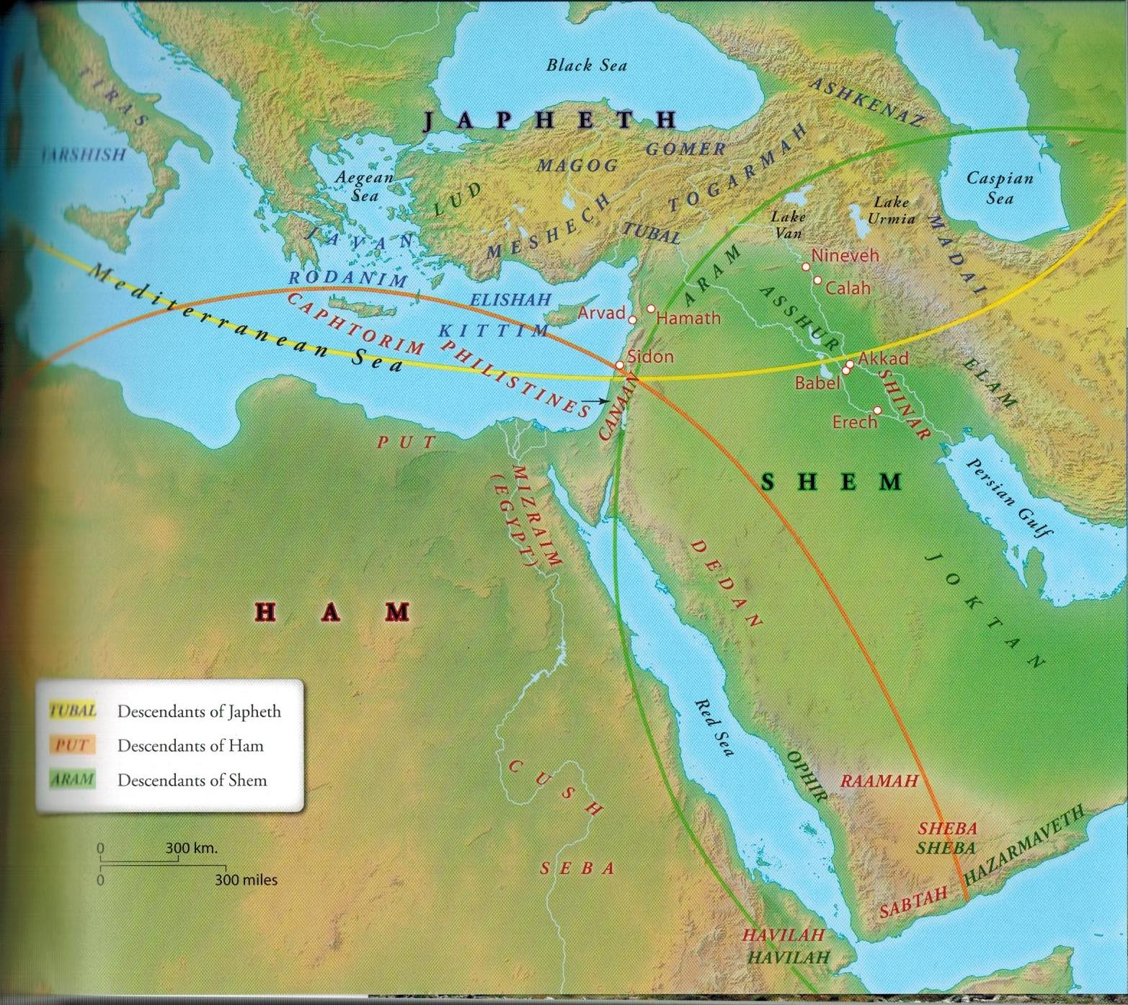
Japheth’s Family
Base Map Template from Zondervan Atlas of the Bible by Carl Rasmussen

Slide 3
Japheth’s Family
Ham’s Family
Base Map Template from Zondervan Atlas of the Bible by Carl Rasmussen

Slide 4
Genesis 10.8-9 NET:
Cush was the father of Nimrod;
he began to be a valiant warrior on the earth.
He was a mighty hunter before the LORD.
גִּבּוֹר = mighty
God noticed

Slide 5
Japheth’s Family
Shem’s Family
Ham’s Family
Base Map Template from Zondervan Atlas of the Bible by Carl Rasmussen

Slide 6
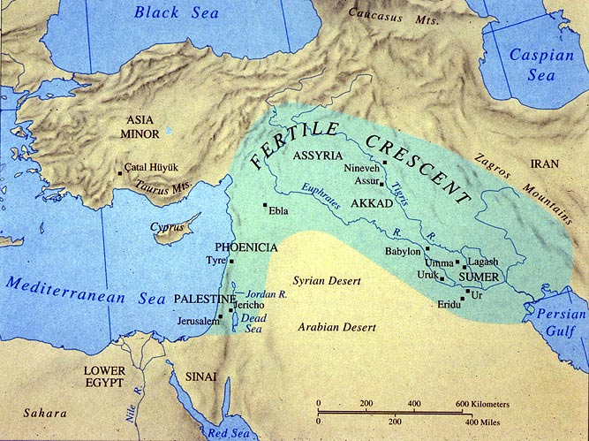
Ark in mountains
Map template
from UTEX.edu

Slide 7
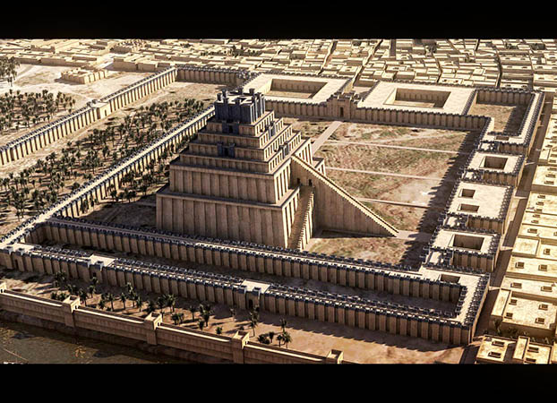
Nebuchadnezzar’s Ziggurat in Babylon
image from kadingirra.com

Slide 8
God
Spiritual
Blessing
100%
Trust & Obey God’s Revelation
Uncertain
YOU
Physical Blessing
Act Apart from Revelation

Slide 9
Japheth’s Family
Shem’s Family
Ham’s Family
Base Map Template from Zondervan Atlas of the Bible by Carl Rasmussen

Slide 10
Japheth’s Family
Shem’s Family
Ham’s Family
Base Map Template from Zondervan Atlas of the Bible by Carl Rasmussen

Slide 11
Japheth’s Family
Shem’s Family
Ham’s Family
Base Map Template from Zondervan Atlas of the Bible by Carl Rasmussen

Slide 12
Adam Noah
created to be image delivered to be image
fell into sin [serpent] fell into sin [alcohol]
family became corrupt family became corrupt
family judged [flood] family judged [division]
new beginning [Noah] new beginning [Abraham]

